Slide 1



REV 2 MLTU-PPPT-A-R2

Slide 2



“It” refers to changes in gynecologic health and it happens to many women as they age.
REV 2 MLTU-PPPT-A-R2

Slide 3



Millions of women may be suffering in silence due to changes to their gynecologic health, but they don’t have to.
REV 2 MLTU-PPPT-A-R2

Slide 4

REV 2 MLTU-PPPT-A-R2

Slide 5


The reason for talking about the MonaLisa Touch.
UNIQUE OPTION FOR PATIENTS
MonaLisa Touch (MLT) is a fractional C0₂ laser that may help with your gynecologic health.
MLTU-PPPT-A-R2
REV 2 MLTU-PPPT-A-R2

Slide 6



MLTU-PPPT-A-R2

Slide 7


For millions of women, MonaLisa Touch is a simple, proven laser device for use in gynecologic health.
MLTU-PPPT-A-R2
REV 2 MLTU-PPPT-A-R2

Slide 8


The reason for talking about the MonaLisa Touch.
FRACTIONAL CO₂ LASER
The MonaLisa Touch laser is a device for gynecologic use that delivers laser energy to tissue. This is followed by the body’s natural healing response.
MLTU-PPPT-A-R2
REV 2 MLTU-PPPT-A-R2

Slide 9

The MonaLisa Touch procedure was the first gynecologic laser offered globally in 2012 and became available in the US in 2014. You can feel confident knowing that it’s a trusted device.
REV 2 MLTU-PPPT-A-R2

Slide 10


MonaLisa Touch is a well-studied laser and has been accepted by experts in female pelvic health around the world.
REV 2 MLTU-PPPT-A-R2

Slide 11


The reason for talking about the MonaLisa Touch.
Unlike other lasers, SmartXide Touch which is used to deliver the MonaLisa Touch procedure, was designed for gynecologic use to meet the needs of OB/GYN patients.
MLTU-PPPT-A-R2
REV 2 MLTU-PPPT-A-R2

Slide 12

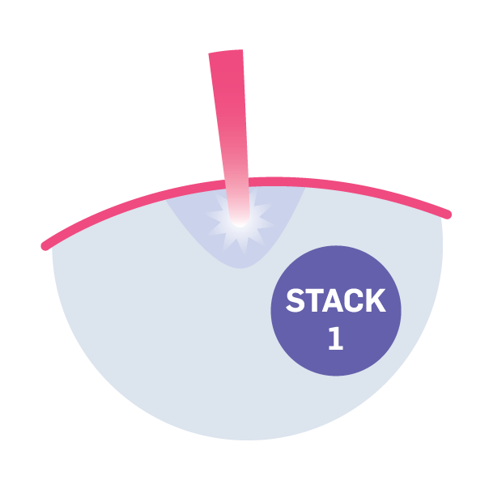
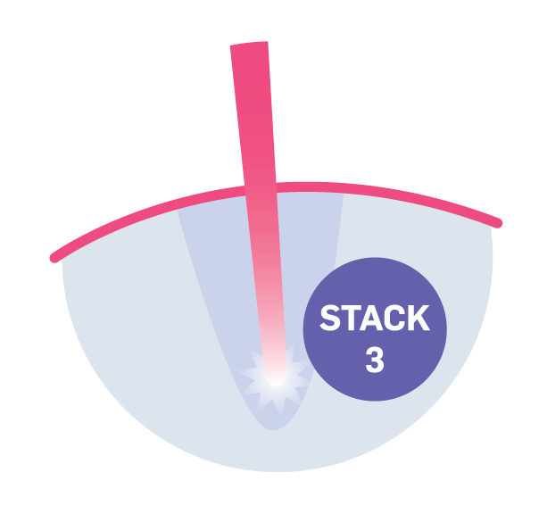
WITH UNIQUE TECHNOLOGY
The fractional laser technology within the MonaLisa Touch device has proprietary stacking technology, which is a repetitive firing of the laser with more concentrated energy to target deeper levels of the tissue.
REV 2 MLTU-PPPT-A-R2

Slide 13



The reason for talking about the MonaLisa Touch.
The global champion of women’s health, dedicated to improving and saving lives through early detection and proactive treatment.
A leading innovator of a broad array of light-based aesthetic and medical treatment systems. Products are used to provide a diverse range of treatment applications such as hair removal, skin revitalization, scar reduction, and more.
MLTU-PPPT-A-R2
REV 2 MLTU-PPPT-A-R2

Slide 14



Slide 15


The procedure is performed here in our office during a routine outpatient appointment.
REV 2 MLTU-PPPT-A-R2

Slide 16


The procedure time is less than
5 minutes and can be scheduled at your convenience.
REV 2 MLTU-PPPT-A-R2

Slide 17


A short series of laser sessions may be recommended by your physician.
REV 2 MLTU-PPPT-A-R2

Slide 18


The MonaLisa Touch procedure typically requires no anesthesia.
REV 2 MLTU-PPPT-A-R2

Slide 19


Most patients resume their routines within a few days of the procedure and side effects are typically mild or unnoticeable in most cases. For a full list of warnings and indications, visit smilemonalisa.com.
REV 2 MLTU-PPPT-A-R2

Slide 20

REV 2 MLTU-PPPT-A-R2

Slide 21


It may be recommended that you wait ~2-3 days for any contact in the lased area. Talk with your physician post-procedure.
REV 2 MLTU-PPPT-A-R2

Slide 22


Everyone is unique and our skin ages pre- and post-procedure. You and your physician should discuss your needs and expectations. Yearly touch-up is recommended.
MLTU-PPPT-A-R2
REV 2 MLTU-PPPT-A-R2

Slide 23

REV 2 MLTU-PPPT-A-R2

Slide 24

REV 2 MLTU-PPPT-A-R2

Slide 25
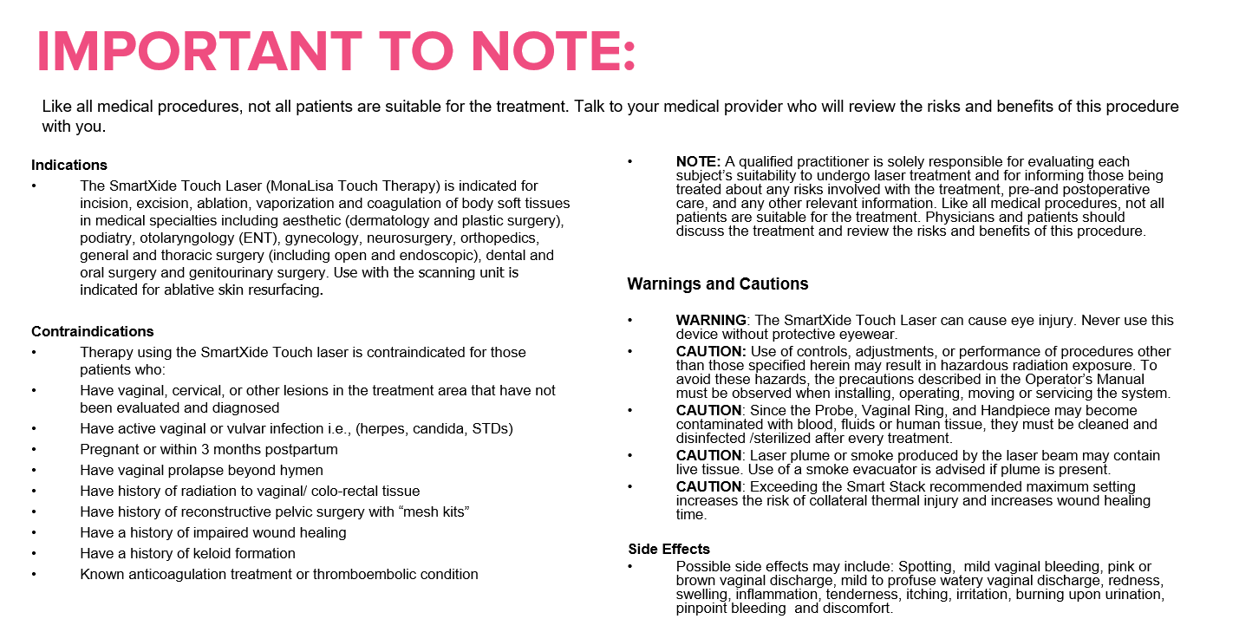


Indications
The SmartXide Touch Laser (MonaLisa Touch Therapy) is indicated for incision, excision, ablation, vaporization and coagulation of body soft tissues in medical specialties including aesthetic (dermatology and plastic surgery), podiatry, otolaryngology (ENT), gynecology, neurosurgery, orthopedics, general thoracic surgery (including open and endoscopic), dental and oral surgery and genitourinary surgery.
Contraindications
Therapy using the SmartXide Touch laser is contraindicated for those patients who:
Have vaginal, cervical, or other lesions in the treatment area that have not been evaluated and diagnosed
Have active vaginal or vulvar infection i.e., (herpes, candida, STDs)
Pregnant or within 3 months postpartum
Have vaginal prolapse beyond hymen
Have history of radiation to vaginal/ colo-rectal tissue
Have history of reconstructive pelvic surgery with “mesh kits”
Have a history of impaired wound healing
Have a history of keloid formation
Known anticoagulation treatment or thromboembolic condition
NOTE: A qualified practitioner is solely responsible for evaluating each subject’s suitability to undergo laser treatment and for informing those being treated about any risks involved with the treatment, pre-and postoperative care, and any other relevant information.
Warnings and Cautions
WARNING: The SmartXide Touch Laser can cause eye injury. Never use this device without protective eyewear.
CAUTION: Use of controls, adjustments, or performance of procedures other than those specified herein may result in hazardous radiation exposure. To avoid these hazards, the precautions described in the Operator’s Manual must be observed when installing, operating, moving or servicing the system.
CAUTION: Since the Probe, Vaginal Ring, and Handpiece may become contaminated with blood, fluids or human tissue, they must be cleaned and disinfected /sterilized after every treatment.
CAUTION: Laser plume or smoke produced by the laser beam may contain live tissue. Use of a smoke evacuator is advised if plume is present.
CAUTION: Exceeding the Smart Stack recommended maximum setting increases the risk of collateral thermal injury and increases wound healing time.
Side Effects
Possible side effects may include: Spotting, mild vaginal bleeding, pink or brown vaginal discharge, mild to profuse watery vaginal discharge, redness, swelling, inflammation, tenderness, itching, irritation, burning upon urination, pinpoint bleeding and discomfort.
REV 2 MLTU-PPPT-A-R2

Slide 26
POTENTIAL RISKS AND SIDE EFFECTS
Possible side effects in the treated area may include:
Mild pinpoint spotting or bleeding
Pink, brown or watery discharge
Redness, swelling, or inflammation
Tenderness, itching, irritation, burning upon urination
Discomfort
Practices may elect to have patient sign a consent form that they are aware of the indications and potential side effects.
MLTU-PPPT-A-R2
REV 2 MLTU-PPPT-A-R2

Slide 27
REV 2 MLTU-PPPT-A-R2

